Slide 1


Crime Incidents in 2024
District of Columbia – Exploratory Data Analysis
Presented by: Priyam Tiwari
Course Code: INT375
Guided by: Mrs. Aashima, SCSE (Data Science), LPU
by Priyam Tiwari

Slide 2



Introduction and Objective
Project Goal
Dataset
Analyze 2024 crime incident reports in Washington DC.
Open government crime data (CSV).
Identify temporal, spatial, and categorical patterns.
Tools Used
Python
Pandas
Matplotlib
Seaborn

Slide 3
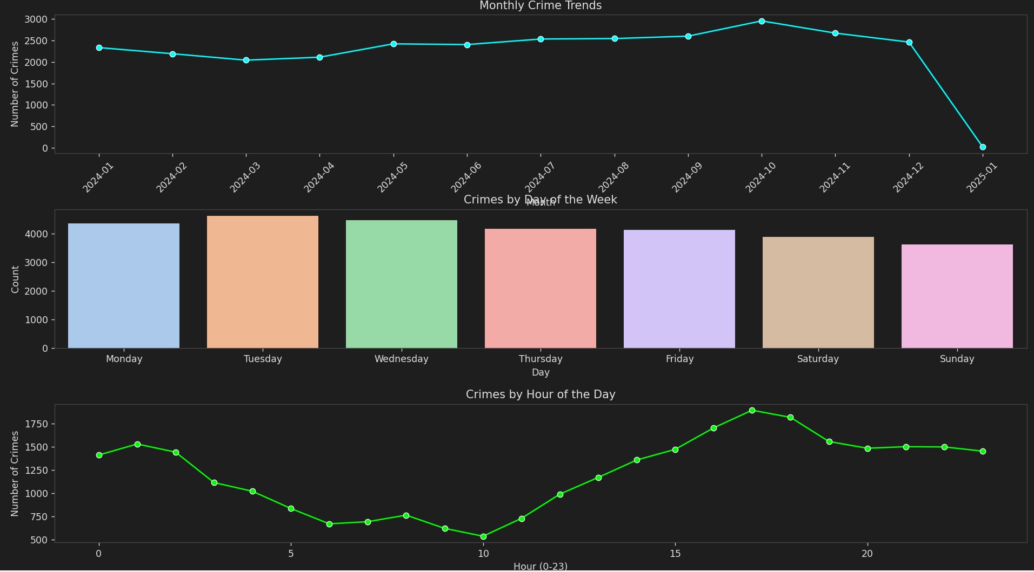





Crime Trends by Time
Monthly Peaks
Weekday Analysis
Highest crime rates observed in July and October.
Friday recorded the highest number of incidents.
Hourly Trends
Significant spike in incidents between 4 PM and 8 PM.

Slide 4
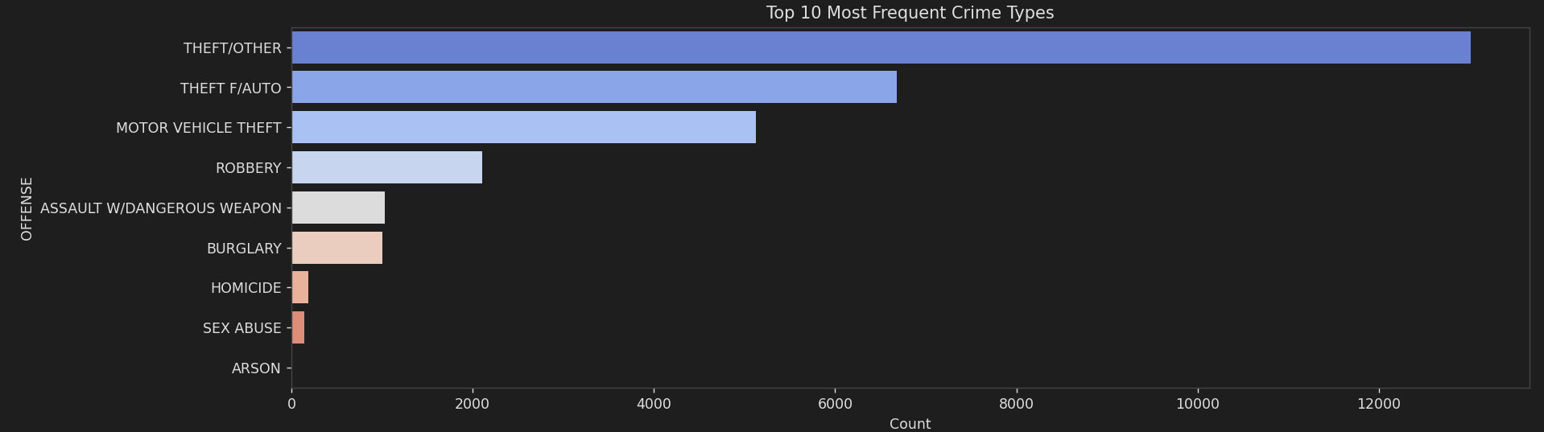





Top 10 Reported Crimes
THEFT/OTHER
1
Most frequent.
2
Motor Vehicle Theft
3
Assault W/Dangerous Weapon

Slide 5
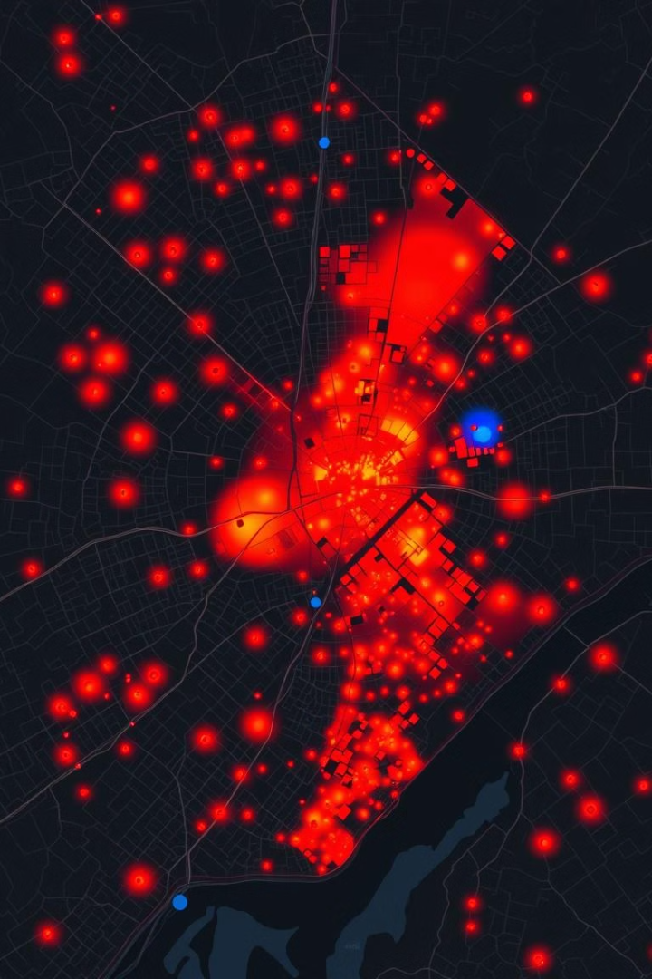



Crimes by Neighborhood & Ward
High Incident Areas
Neighborhood Hotspots
Spatial Clustering
Most incidents occur in Columbia Heights, Shaw, and Downtown. Wards 1 & 6 lead. Spatial clustering helps prioritize policing strategies.

Slide 6








Law Enforcement Response Analysis
Quick Responses
Most responses occur within 100 minutes.
Response Time
Calculated time between incident and report.
Distribution
Histogram used for visual distribution.

Slide 7
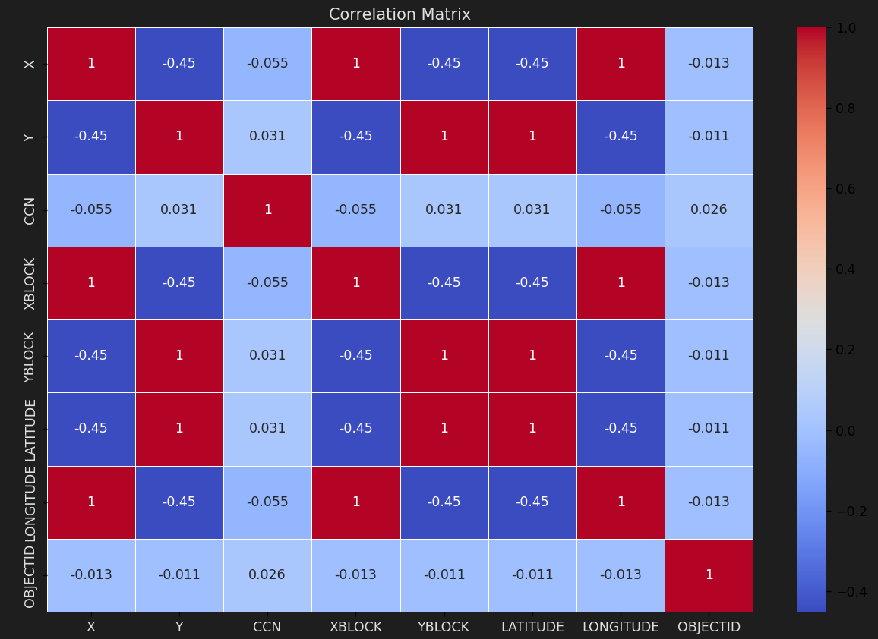
Statistical Analysis
Outlier Detection
Z-score method used to identify outliers.
Correlations
Weak correlations found between numeric variables.
Feature Exploration
RESPONSE_MINUTES explored in heatmap.

Slide 8

Key Findings
Temporal Patterns
Crimes peak during evening and weekends.
Dominant Offense
Theft is the most common crime reported.
Strategic Focus
Certain neighborhoods require increased attention.
Response Efficiency
Timely reporting indicates decent response efficiency.

Slide 9
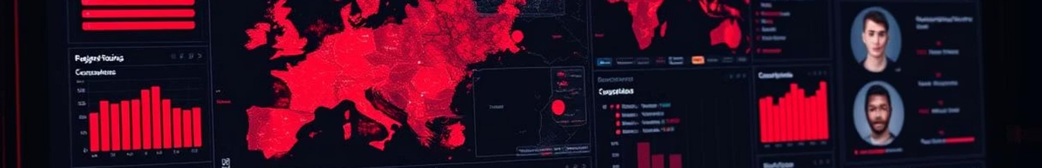






Enhancing Crime Prediction
ML Models
Build ML models for predictive policing.
GIS Integration
Integrate with city GIS for live mapping.
Real-Time Dashboards
Use real-time dashboards & alerts.
Improve public safety with proactive data science.

